Slide 1

Flower Image Classification Using CNN
VELISHALA ABHIVARUN 2203A52062 BATCH-36

Slide 2
INTRODUCTION
This project demonstrates a Computer Vision-based multi-class image classification system designed to recognize five different types of flowers using Convolutional Neural Networks(CNN).
The project showcases the practical application of CNN architecture for image recognition tasks in a balanced dataset of 5,000 flower images.
The system classifies Lily, Lotus, Sunflower, Orchid and Tulip flowers using computer vision and deep learning techniques.
The main aim of this flower image classification is to detect and classify different type of flowers from input images and shows the accuracy of input image.
This project aims to design and implement a CNN-based model that can accurately classify flower images into their respective categories.

Slide 3
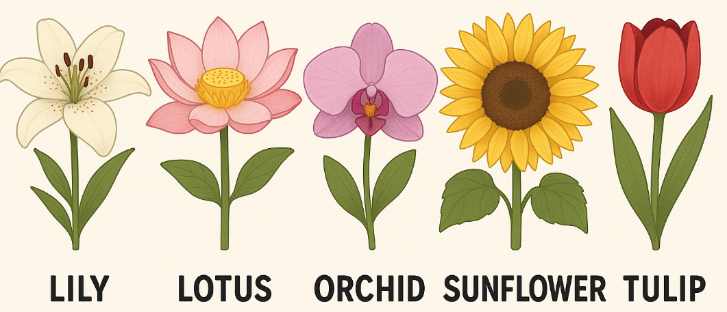
Project Overview
Dataset Composition
5 flower classes with 1000 images each: Lily, Lotus, Sunflower, Orchid and Tulip
Libraries Used
TensorFlow, Keras, NumPy, Matplotlib and Image Data Generator for preprocessing
Classification Approach
Multi-class image classification using CNN architecture with categorical cross-entropy loss

Slide 4
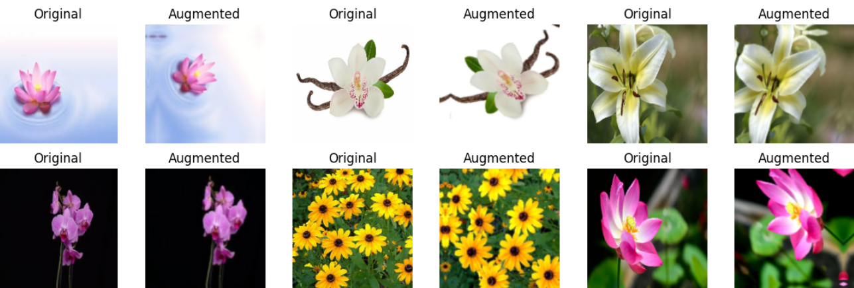
Data Augmentation
Rescaling:
Pixel values are normalized by rescaling from 0-255 to 0-1 range to improve training stability.
Data Augmentation:
Techniques like rotation, zoom and flip are applied to artificially expand the dataset and improve model generalization.
The dataset is structured with separate subfolders for each flower class, following the flow_from_directory format.
This organization enables efficient batch processing during training.
The final shape of each image batch is (32, 180, 180, 3), representing 32 images per batch with 180×180 resolution and 3 color channels.

Slide 5

CNN- ALEXNET MODEL
AlexNet is a Convolutional Neural Network architecture that won the ImageNet Large Scale Visual Recognition Challenge (ILSVRC) in 2012, significantly outperforming traditional machine learning methods at the time.
It marked a major breakthrough in computer vision by significantly reducing the top-5 error rate.
Input Image (224x224x3)
↓
Conv(11x11) → ReLU → MaxPool
↓
Conv(5x5) → ReLU → MaxPool
↓
Conv(3x3) → ReLU
↓
Conv(3x3) → ReLU
↓
Conv(3x3) → ReLU → MaxPool
↓
Flatten → Dense(4096) → Dropout
↓
Dense(4096) → Dropout
↓
Dense(5) → Softmax (for classification)

Slide 6
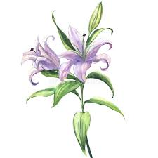

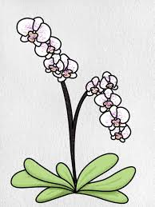
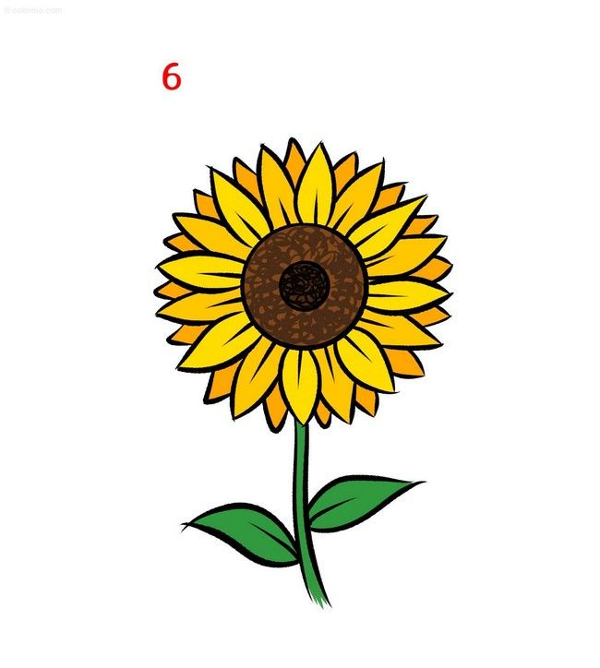

classification report
LILY🌸
821 samples
Precision: 0.59
Recall: 0.84
F1-score: 0.69
TULIP🌷
785 samples
Precision: 0.93
Recall: 0.76
F1-score: 0.83
ORCHID🪻 800 samples
Precision: 0.82
Recall: 0.74
F1-score: 0.78
SUNFLOWER🌻
791 samples
Precision: 0.96
Recall: 0.92
F1-score: 0.94
LOTUS🪷
803 samples
Precision: 0.85
Recall: 0.83
F1-score: 0.84

Slide 7
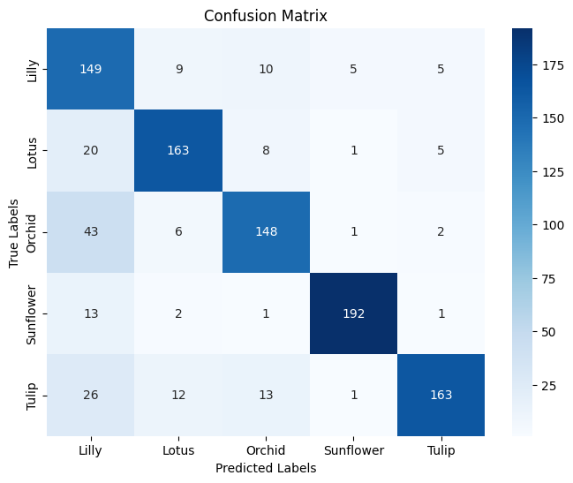
CONFUSION MATRIX
The confusion matrix shows the performance of a flower classification model across five classes: Lily, Lotus, Orchid, Sunflower and Tulip.
Most predictions are accurate along the diagonal, with highest accuracy for Sunflower.
Misclassifications are minimal, except Orchid misclassified as Lily 43 times. Overall, the model performs well.
Correct Predictions: → Lilly: 149 → Lotus: 163 → Orchid: 148 → Sunflower: 192 → Tulip: 163

Slide 8
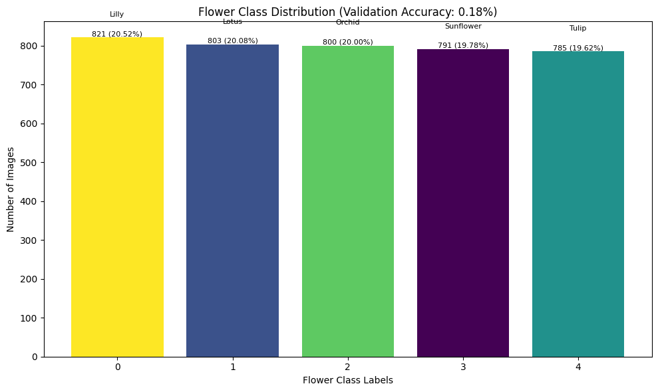
HISTOGRAM FOR FLOWER CLASSIFICATION
The flower class distribution is nearly balanced with each class having around 800 images.
Lily has the most (821) and Tulip the least (785).
This balance ensures fair model training across all categories.
However, the very low validation accuracy suggests poor model performance or possible
issues with data preprocessing or labeling.
Class | Label | # of Images | Percentage
Lilly | 0 | 821 | 20.52%
Lotus | 1 | 803 | 20.08%
Orchid | 2 | 800 | 20.00%
Sunflower | 3 | 791 | 19.78%
Tulip | 4 | 785 | 19.62%

Slide 9
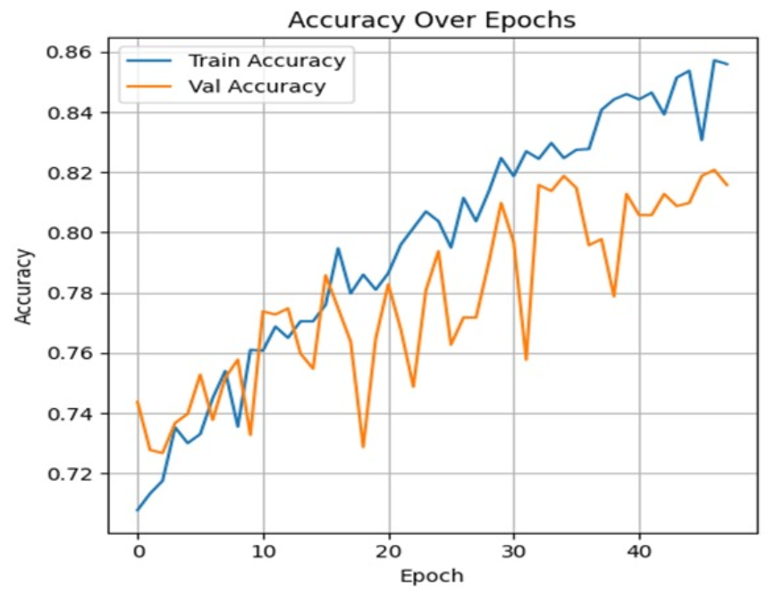
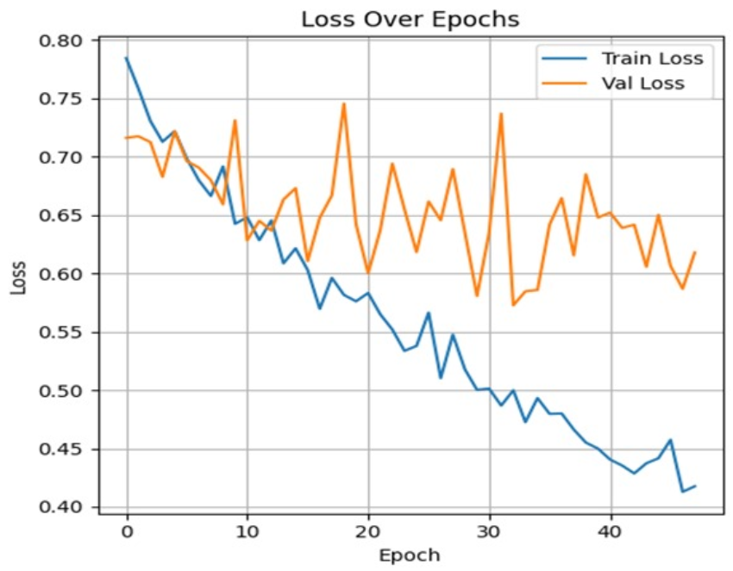
GRAPH- Accuracy and Loss
The accuracy graph shows a steady increase in training accuracy, reaching around 86%, while validation accuracy fluctuates but improves overall to nearly 82%. The gap between training and validation accuracy suggests slight overfitting. Despite fluctuations, both metrics indicate that the model is learning and generalizing reasonably well across the epochs.
The loss graph shows a steady decrease in training loss, indicating effective learning. However, validation loss remains higher and fluctuates, suggesting possible overfitting. The widening gap between train and validation loss after 20 epochs implies the model performs well on training data but struggles to generalize to unseen data.

Slide 10
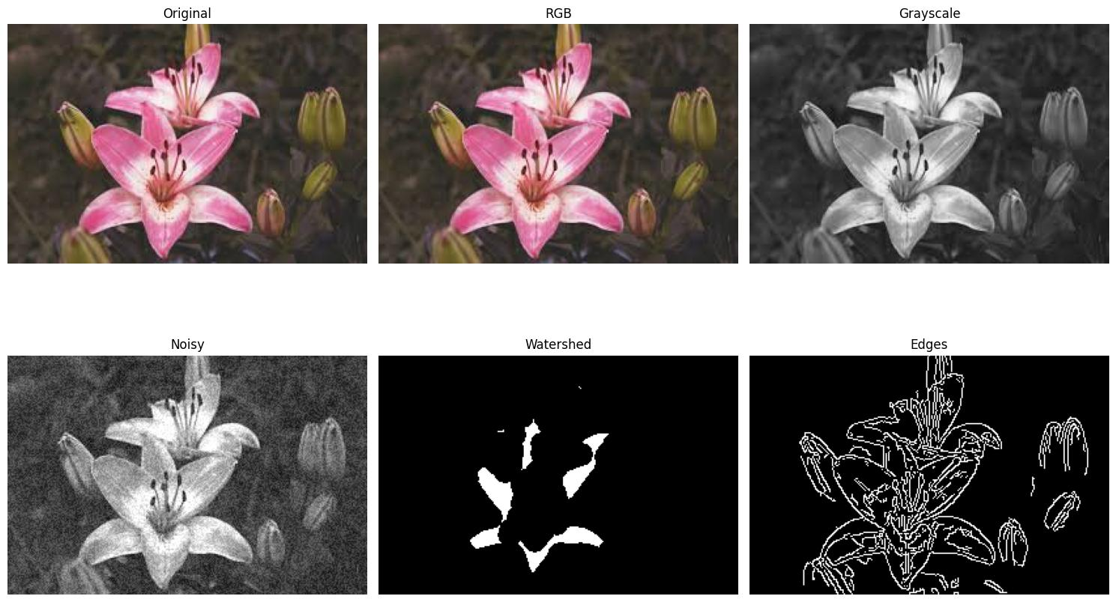
IMAGE FILTERS TO A FLOWER
The image shows a flower processed through various computer vision techniques: original, RGB, grayscale, noisy, watershed segmentation and edge detection.
These transformations help in feature extraction, object segmentation and noise handling essential for accurate classification in flower image recognition models using machine learning.
The original and RGB images preserve color information, while grayscale simplifies data by removing color. Noisy adds distortion for robustness testing. Watershed helps in segmenting overlapping petals. Edge detection outlines the flower’s structure aiding in shape-based analysis.

Slide 11










Performance Analysis by Flower Type
Tulip
High precision (0.93) but lower recall (0.76), indicating some tulips are misclassified as other flowers
Sunflower
Best performing class with 0.96 precision and 0.92 recall likely due to distinctive yellow petals and dark centers
Lotus
Well-balanced metrics with 0.85 precision and 0.83 recall, showing consistent recognition
Lily
Lowest precision (0.59) but high recall (0.84), indicating the model frequently classifies other flowers as lilies
Orchid
Good precision (0.82) with moderate recall (0.74) suggesting some challenges in identification

Slide 12





CNN Model Architecture
The model contains 3,989,285 trainable parameters (15.22 MB) organized in a sequential architecture. It uses ReLU activation in convolutional layers to extract features, followed by pooling layers to reduce dimensions while preserving important information.
Output Layer
Dense layer with Softmax activation for 5 classes
Hidden Layers
Dense (128 neurons) and Dropout for regularization
Feature Extraction
Multiple Conv2D and MaxPooling2D layers
Input Processing
Rescaling layer for normalization (180×180×3)

Slide 13




Conclusion and Future Improvements
Achievements
Successfully implemented a CNN model achieving 81.58% test accuracy on a balanced dataset of 5 flower classes
Insights
Identified class-specific performance variations with sunflowers being most accurately classified (0.94 F1-score) and lily presenting the greatest challenge (0.69 F1-score)
Potential Improvements
Future work could focus on enhancing lily classification through targeted data augmentation, feature engineering or transfer learning with pre-trained models
Applications
The model demonstrates practical applications in botanical research, educational tools and plant identification apps

